Slide 1
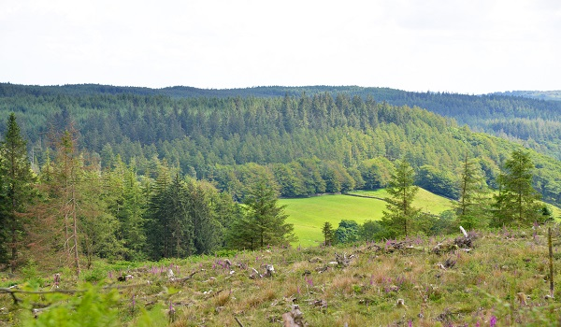
Renewable Energy in the UK:
Are We on Track for Net Zero?

Slide 2
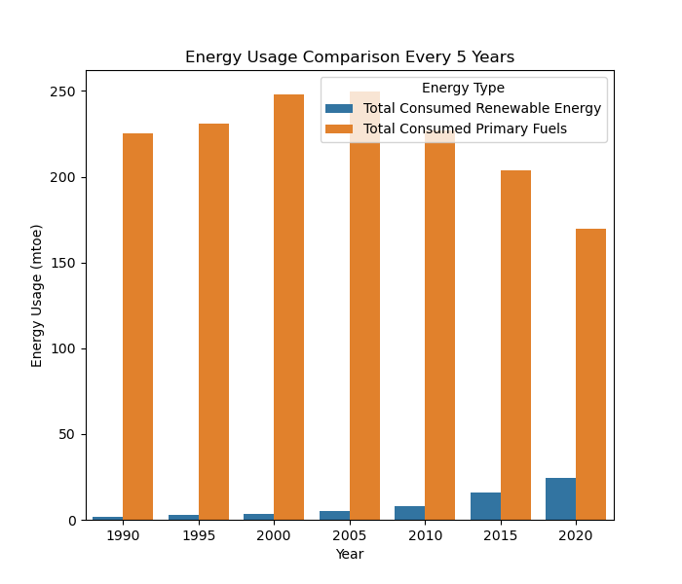
Why Should We Care About Renewables?
Reduce Climate Change
Sustainable Supply
Improved Public Health
Job Creation
What is Net Zero?
By 2030: target of 70% renewable electricity generation.
By 2050: Very high proportion, potentially close to 100% for electricity generation.
Notes:
Renewable energy produces little to no greenhouse gases, helping mitigate global warming.
Unlike fossil fuels, renewables (like solar and wind) won't run out, ensuring long-term energy security.
Cleaner air from renewables means fewer respiratory issues and health costs.
: The renewable energy industry creates new opportunities in manufacturing, installation, and maintenance.
Countries relying on renewable energy are less dependent on imported fossil fuels, boosting energy security.

Slide 3
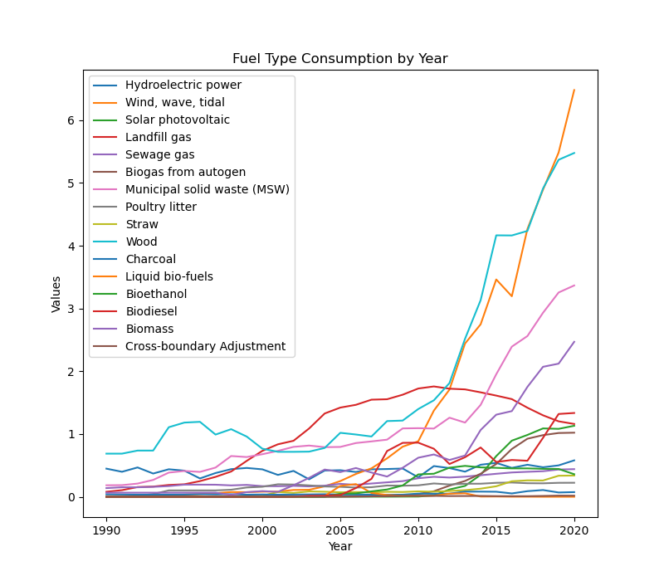
Energy Use from Renewable and Waste (UK)
Source: The Office for National Statistics (ONS).
Time-frame: 1990 to 2020.
Content: Data on the UK's energy consumption from primary fuels, renewable and waste sources.
Key Findings:
Significant Growth
Biomass Dominance
Notes:
Renewable energy consumption exceeded 10% of total energy use in 2017
Biomass is the largest renewable energy source in the UK.
Biomass is the largest renewable energy source in the UK.
Biomass is the largest renewable energy source in the UK.

Slide 4
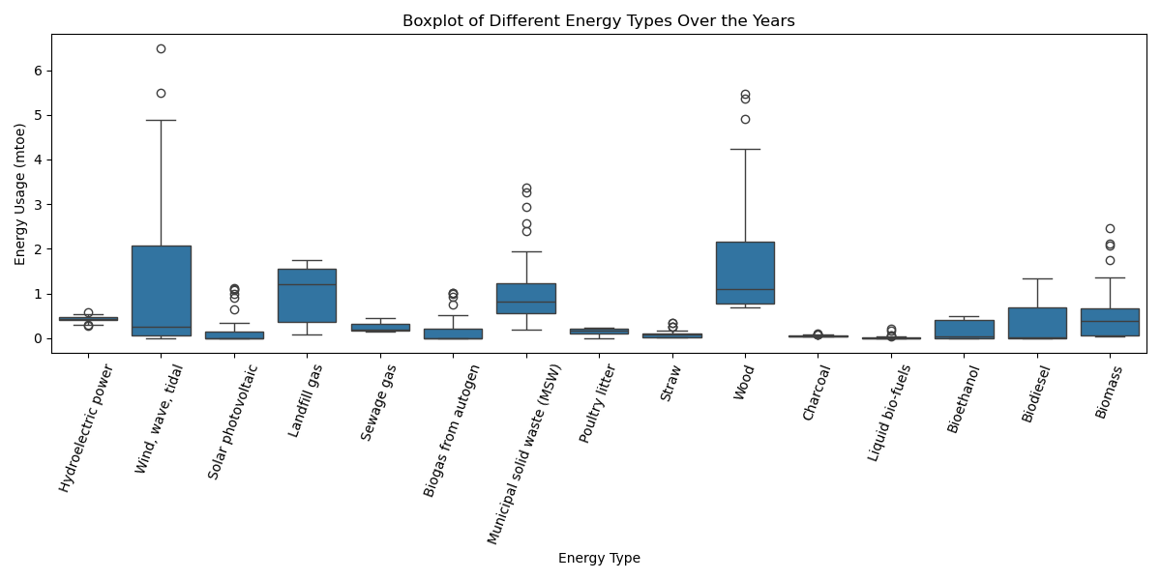
Usages of Each Renewable Type

Slide 5
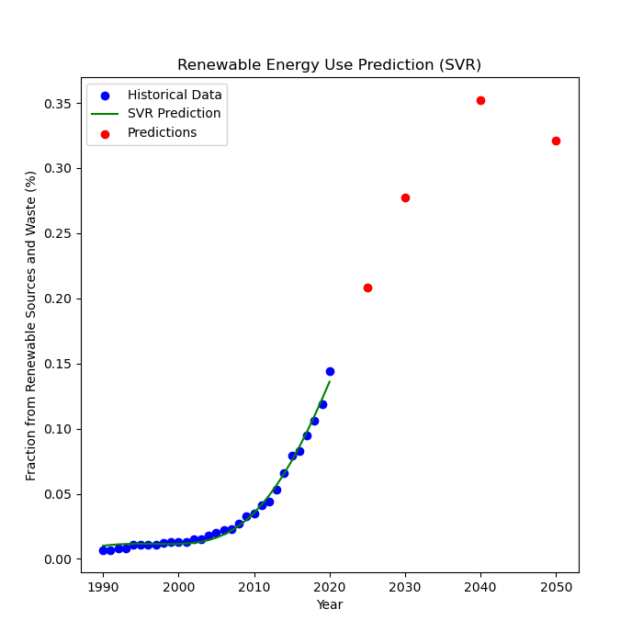
Building a Model & Making Predictions (1)
What the model is doing: The model uses past data to find a boundary that predicts the proportion of renewable energy based on the year.
What the findings were: The model predicts percentage of renewables to be 28% in 2030 and 32% in 2050.
Accuracy: The model has an R² of 0.99, indicating a good fit to the historical data.

Slide 6
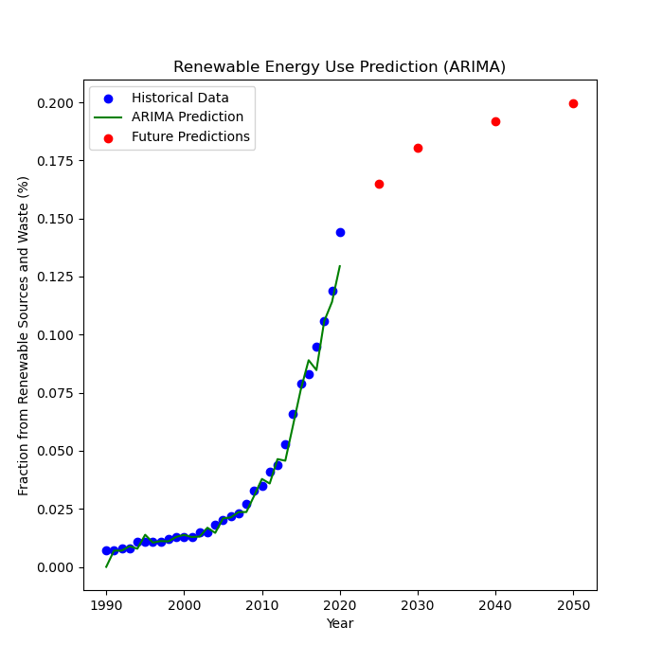
Building a Model & Forecasting (2)
What the model is doing: The model looks at the trend over time and uses that pattern to predict future values of renewable energy usage.
What the findings were: The model predicts percentage of renewables to be 18% in 2030 and 20% in 2050.
Accuracy: The model has an R² of 0.99, meaning it performs well on the historical data but might be sensitive to the trend.

Slide 7
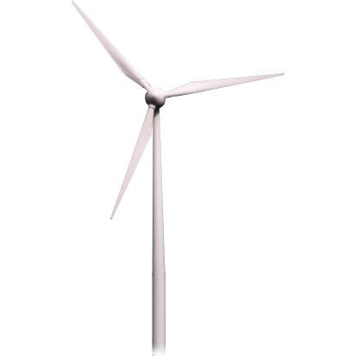
Conclusions, Limitations & Improvements
Conclusions: Both models suggest renewable energy use is growing but not fast enough to meet targets.
Limitations: The models don’t factor in policy changes, technological advances, or economic shifts that could affect progress.
Improvements: Regularly update projections to include emerging technologies and new data.

Slide 8
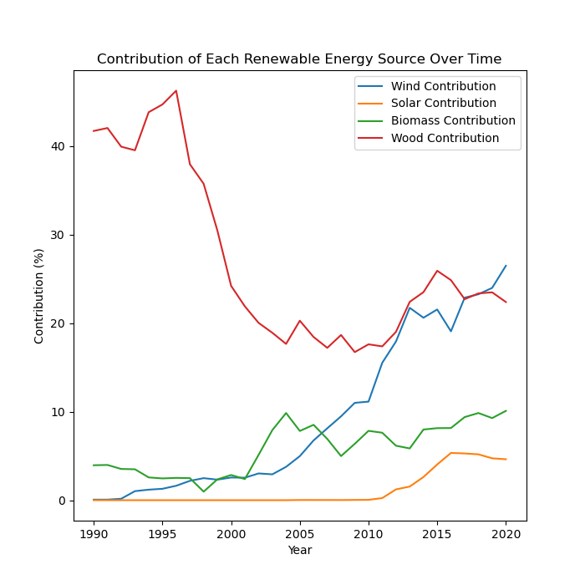
Final Analysis & Recommendations
External reports show that Wind & Solar are much more cost effective and scalable
Recommendations:
Focus on growth in wind & solar over wood & biomass
Increase renewable energy investment and adopt low-carbon technologies.
Strengthen policies supporting green energy and carbon capture.

Slide 9
Thank you for listening!

